Slide 1




+
William Stallings Computer Organization and Architecture
10th Edition (Chp 3 & 4
© 2016 Pearson Education, Inc., Hoboken,
NJ. All rights reserved.

Slide 2

⁺ Computer Components
Contemporary computer designs are based on concepts developed by John von Neumann at the Institute for Advanced Studies, Princeton
Referred to as the von Neumann architecture and is based on
three key concepts:
  Data and instructions are stored in a single read-write memory
  The contents of this memory are addressable by location, without regard to the type of data contained there
  Execution occurs in a sequential fashion (unless explicitly
modified) from one instruction to the next
Hardwired program
  The result of the process of connecting the various components in the desired configuration

Slide 3




+
Sequence of arithmetic and logic functions
Data
Results
(a) Programming in hardware
Hardware and Software Approaches
Instruction
Instruction interpreter
codes
Control signals
General-purpose arithmetic and logic functions
Data
Results
(b) Programming in software
Suppose we construct a general-purpose configuration of arithmetic and logic functions. This set of hardware will perform various functions on data depending on control signals applied to the hardware. In the original case of customized hardware, the system accepts data and produces results (Figure 3.1a). With general-purpose hardware, the system accepts data and control signals and produces results. Thus, instead of rewiring the hardware for each new program, the programmer merely needs to supply a new set of control signals.
© 2016 Pearson Education, Inc., Hoboken, NJ. All rights reserved.
Figure 3.1 Hardware and Software Approaches

Slide 4









Software
Software
A sequence of codes or instructions
Part of the hardware interprets each instruction and
generates control signals
Provide a new sequence of codes for each new program instead of rewiring the hardware
Major components:
CPU
  Instruction interpreter
  Module of general-purpose arithmetic and logic functions
I/O Components
I/O Components
Input module
  Contains basic components for accepting data and instructions and converting them into an internal form of signals usable by the system
Output module
  Means of reporting results
+

Slide 5
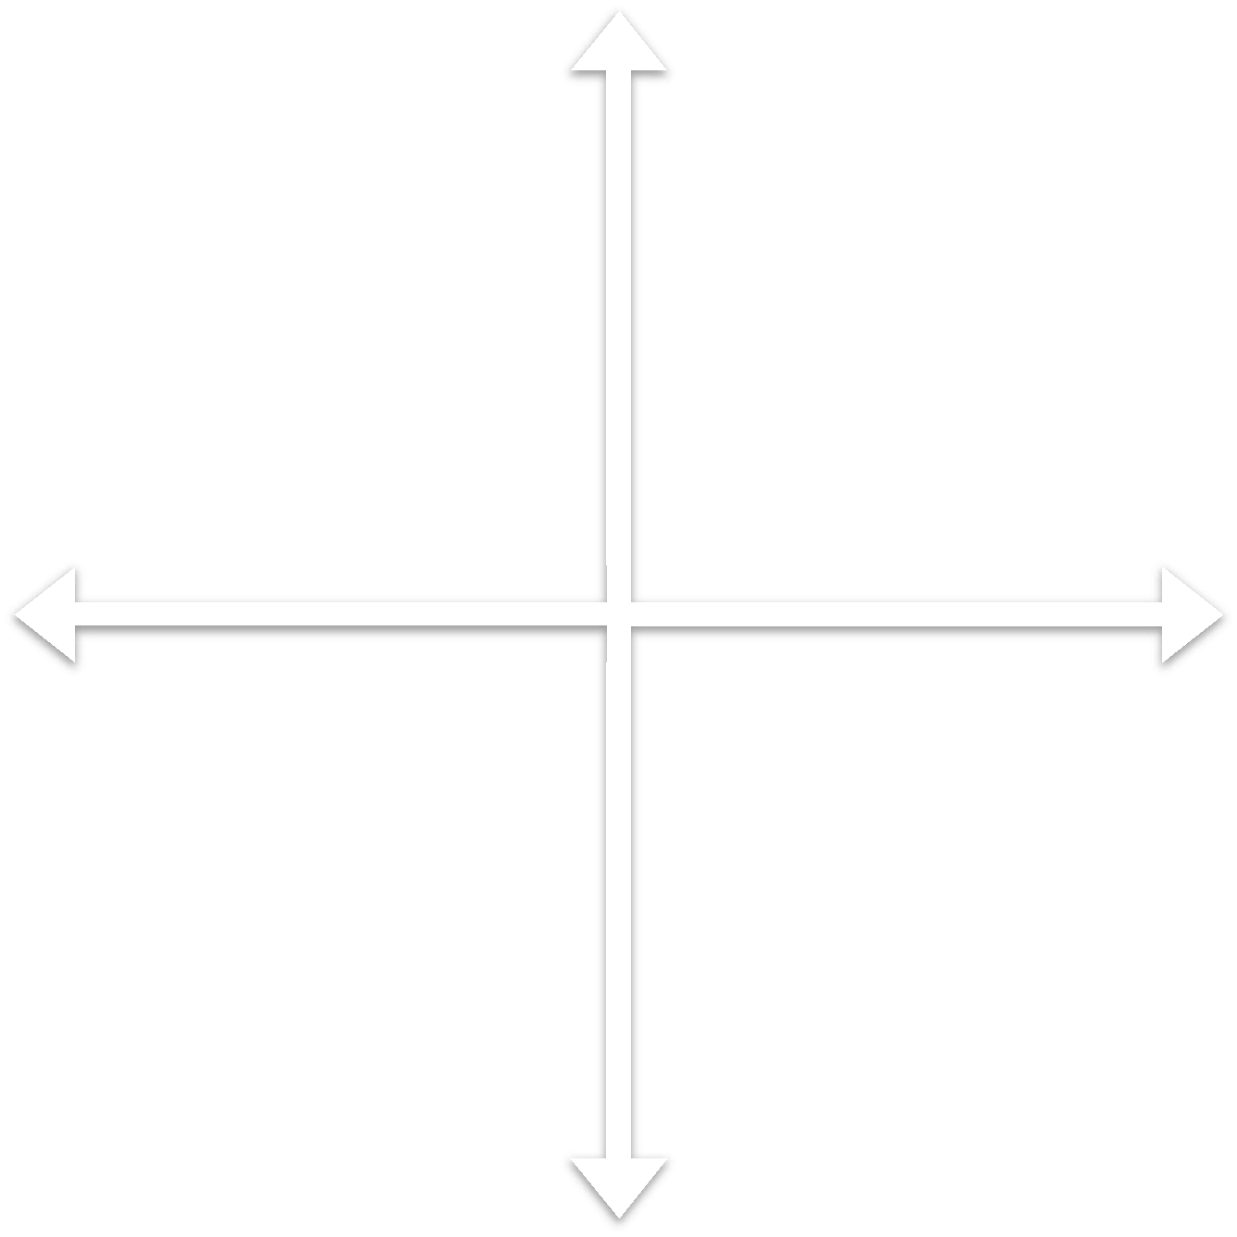
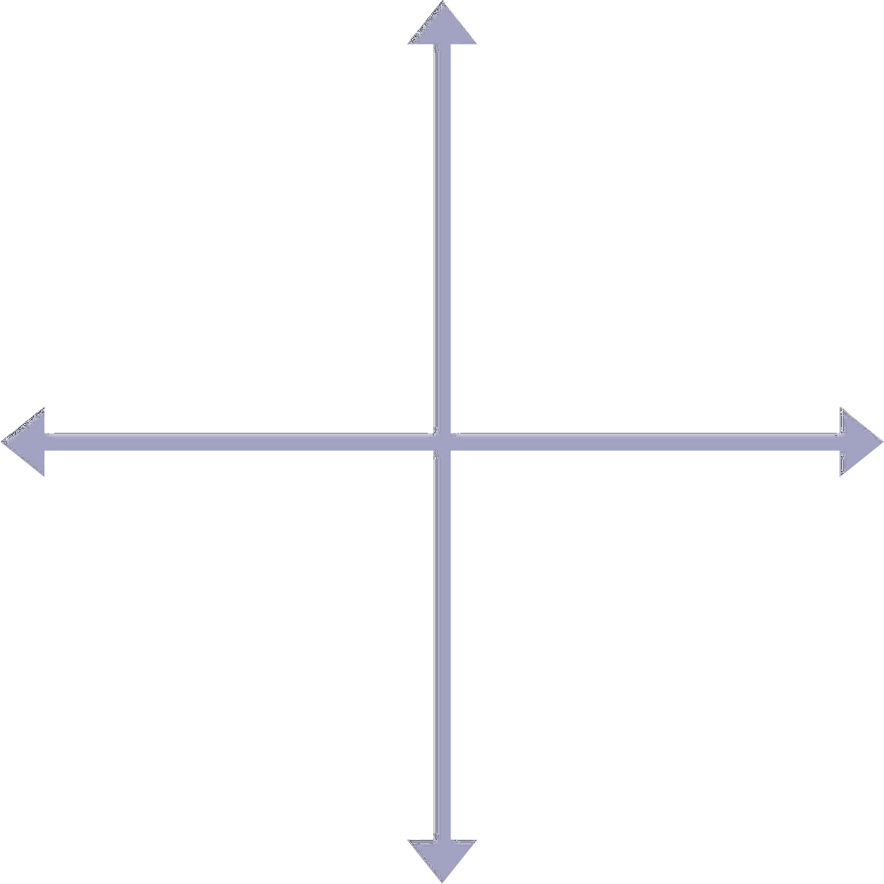




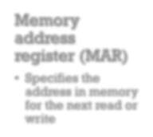
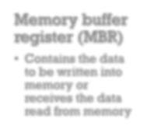











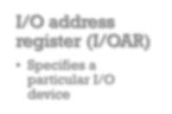
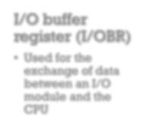






MEMORY
Memory address register (MAR)
Specifies the address in memory for the next read or write
Memory buffer
register (MBR)
Contains the data to be written into memory or receives the data read from memory
MAR
I/O address register (I/OAR)
Specifies a particular I/O device
I/O buffer register (I/OBR)
Used for the exchange of data between an I/O module and the CPU
+
MBR

Slide 6
CPU
Main Memory
Execution unit
System
Instruction
Instruction
Instruction
Data
Data
Data
Data
0
1
2
PC
MAR
Bus
IR
MBR
I/O AR
I/O BR
I/O Module
n – 2
n – 1
Buffers
PC | = | Program counter
IR | = | Instruction register
MAR | = | Memory address register
MBR | = | Memory buffer register
I/O AR | = | Input/output address register
I/O BR | = | Input/output buffer register
Figure 3.2 Computer Components: Top-Level View

Slide 7
Fetch Cycle
Execute Cycle
START
Fetch Next Instruction
Execute Instruction
HALT
Figure 3.3 Basic Instruction Cycle

Slide 8


⁺ Fetch Cycle
At the beginning of each instruction cycle the processor
fetches an instruction from memory
The program counter (PC) holds the address of the instruction to be fetched next
The processor increments the PC after each instruction
fetch so that it will fetch the next instruction in sequence
The fetched instruction is loaded into the instruction
register (IR)
The processor interprets the instruction and performs the required action

Slide 9
























Action Categories
Data transferred from processor to memory or from memory to processor
Data transferred to or from a peripheral device by transferring between the processor and an I/O module
Processor-
memory
Processor-
I/O
Control
Data processing
An instruction may specify that the sequence of execution be altered
The processor may perform some arithmetic or logic operation on data

Slide 10
0
3 4
15
Opcode | Address
(a) Instruction format
0 1
15
S | Magnitude
Integer format
Program Counter (PC) = Address of instruction Instruction Register (IR) = Instruction being executed Accumulator (AC) = Temporary storage
Internal CPU registers
0001 = Load AC from Memory 0010 = Store AC to Memory 0101 = Add to AC from Memory
Partial list of opcodes
Figure 3.4 Characteristics of a Hypothetical Machine

Slide 11
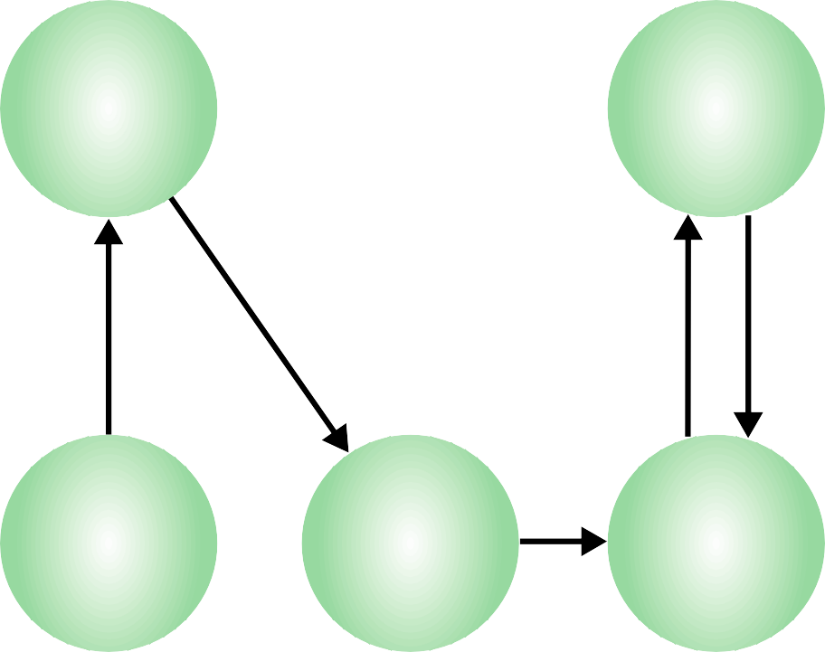
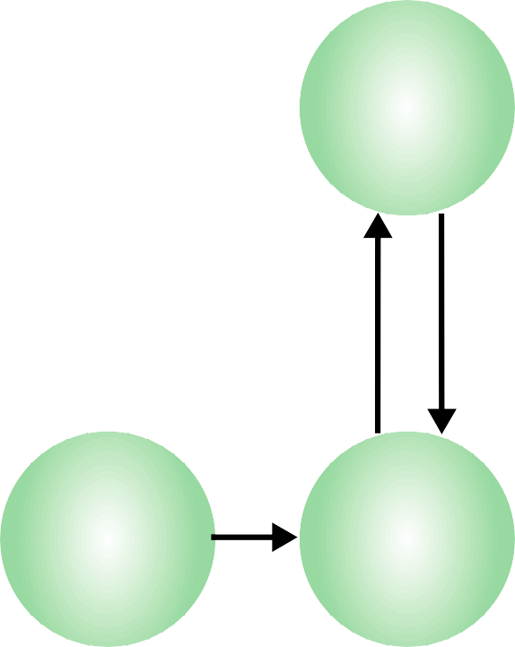
Instruction fetch
Operand fetch
Operand store
Multiple operands
Multiple results
Instruction address calculation
Instruction operation decoding
Operand address calculation
Data Operation
Operand address calculation
Return for string or vector data
Instruction complete, fetch next instruction
Figure 3.6
Instruction Cycle State Diagram

Slide 12
⁺ Interrupt
The interrupt is a signal emitted by hardware or software when a process or an event needs immediate attention. It alerts the processor to a high-priority process requiring interruption of the current working process. In I/O devices one of the bus control lines is dedicated for this purpose and is called the Interrupt Service Routine (ISR).
When a device raises an interrupt at let’s say process i, the processor first completes the execution of instruction i. Then it loads the Program Counter (PC) with the address of the first instruction of the ISR. Before loading the Program Counter with the address, the address of the interrupted instruction is moved to a temporary location. Therefore, after handling the interrupt the processor can continue with process i+1.
While the processor is handling the interrupts, it must inform the device that its request has been recognized so that it stops sending the interrupt request signal. Also, saving the registers so that the interrupted process can be restored in the future, increases the delay between the time an interrupt is received and the start of the execution of the ISR. This is called Interrupt Latency.

Slide 13
⁺ Type of interrupt
Software Interrupts: A sort of interrupt called a software interrupt is one that is produced by software or a system as opposed to hardware. Traps and exceptions are other names for software interruptions. They serve as a signal for the operating system or a system service to carry out a certain function or respond to an error condition. A particular instruction known as a “interrupt instruction” is used to create software interrupts. When the interrupt instruction is used, the processor stops what it is doing and switches over to a particular interrupt handler code. The interrupt handler routine completes the required work or handles any errors before handing back control to the interrupted application.
Hardware Interrupts: In a hardware interrupt, all the devices are connected to the Interrupt Request Line. A single request line is used for all the n devices. To request an interrupt, a device closes its associated switch. When a device requests an interrupt, the value of INTR is the logical OR of the requests from individual devices.

Slide 14
Generated by some condition that occurs as a result of an instruction execution, such as arithmetic overflow, division by zero, attempt to execute an illegal machine instruction, or reference outside a user's allowed memory space.
Program
Timer
Generated by a timer within the processor. This allows the operating system to perform certain functions on a regular basis.
Generated by an I/O controller, to signal normal completion of an operation, request service from the processor, or to signal a variety of error conditions.
Generated by a failure such as power failure or memory parity error.
I /O
Hardware failure
Table 3.1
Classes of Interrupts

Slide 15
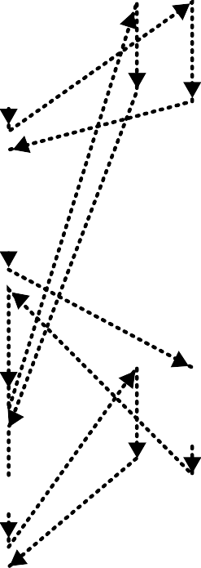
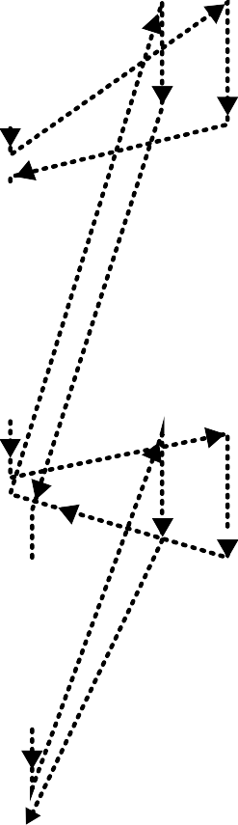

















User Program
I/O Program
User Program
I/O Program
User Program
I/O Program
1
4
1
4
1
4
I/O Command
I/O Command
I/O Command
WRITE
WRITE
WRITE
5
2a
END
2
2
2b
Interrupt Handler
Interrupt Handler
WRITE
WRITE
5
WRITE
5
END
END
3a
3
3
3b
WRITE
WRITE
WRITE
(a) No interrupts
(b) Interrupts; short I/O wait
(c) Interrupts; long I/O wait
= interrupt occurs during course of execution of user program
Figure 3.7 Program Flow of Control Without and With Interrupts

Slide 16
User Program
Interrupt Handler
1
2
i
i + 1
Interrupt
occurs here
M
Figure 3.8
Transfer of Control via Interrupts

Slide 17
Fetch Cycle
Execute Cycle
Interrupt Cycle
Interrupts Disabled
Fetch Next Instruction
Execute Instruction
Check for Interrupt;
START
Interrupts Enabled
Process Interrupt
HALT
Figure 3.9 Instruction Cycle with Interrupts

Slide 18

Time
1
4
5
2
4
5
3
1
4
2a
5
2b
4
3a
5
3b
I/O operation; processor waits
I/O operation concurrent with processor executing
I/O operation concurrent with processor executing
I/O operation; processor waits
(b) With interrupts
(a) Without interrupts
Figure 3.10
Program Timing: Short I/O Wait

Slide 19















Time
1
4
2
5
4
3
5
1
4
5
2
4
5
3
I/O operation; processor waits
I/O operation concurrent with processor executing; then processor
waits
I/O operation concurrent with processor executing; then processor
waits
I/O operation; processor waits
(b) With interrupts
(a) Without interrupts
Figure 3.11
Program Timing: Long I/O Wait

Slide 20
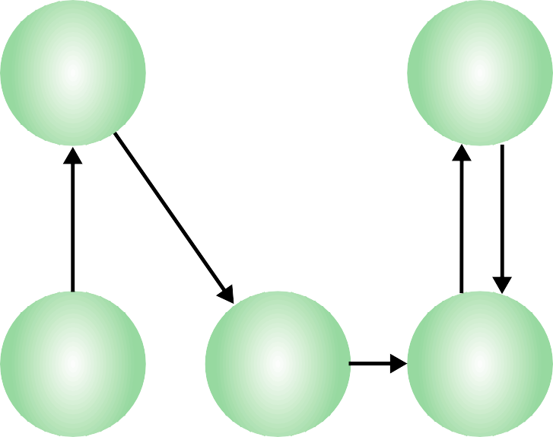
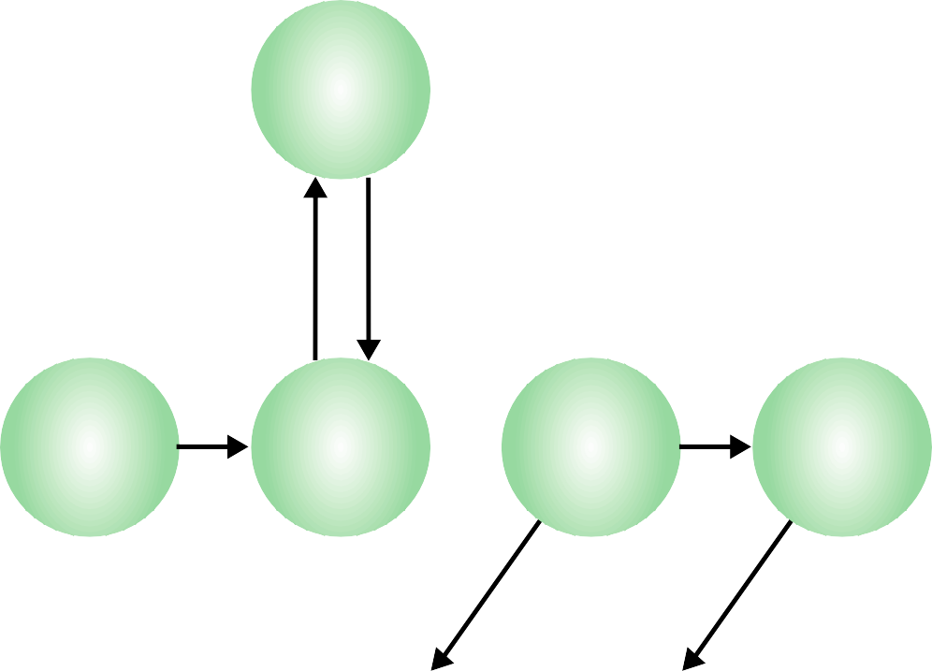
Instruction fetch
Operand fetch
Operand store
Multiple operands
Multiple results
Instruction address calculation
Instruction operation decoding
Operand address calculation
Data Operation
Operand address calculation
Interrupt check
Interrupt
Instruction complete, fetch next instruction
Return for string or vector data
No interrupt
Figure 3.12
Instruction Cycle State Diagram, With Interrupts

Slide 21
Multiple Interrupts
+
Disable interrupt
processor will ignore further interrupts whilst processing one interrupt
Interrupts remain pending and are checked after first interrupt has been processed
Interrupts handled in sequence as they occur
Define priorities
Low priority interrupts can be interrupted by higher priority interrupts
When higher priority interrupt has been processed processor returns to previous interrupt

Slide 22

Interrupt handler X
User program
Interrupt handler Y
(a) Sequential interrupt processing
Interrupt handler X
User program
Interrupt handler Y
(b) Nested interrupt processing
Figure 3.13 Transfer of Control with Multiple Interrupts

Slide 23
User program
Printer interrupt service routine
Communication interrupt service routine
t = 0
t = 15
t = 10
t = 25
t = 2
20
Disk
interrupt service routine
t = 40
5
t = 35
Figure 3.14
Example Time Sequence of Multiple Interrupts

Slide 24

⁺ I/O Function
I/O module can exchange data directly with the processor
Processor can read data from or write data to an I/O module
  Processor identifies a specific device that is controlled by a
particular I/O module
  I/O instructions rather than memory referencing instructions
In some cases it is desirable to allow I/O exchanges to occur directly with memory
  The processor grants to an I/O module the authority to read from or write to memory so that the I/O memory transfer can occur without tying up the processor
  The I/O module issues read or write commands to memory
relieving the processor of responsibility for the exchange
  This operation is known as direct memory access (DMA)

Slide 25
Read
Memory
N Words
0
N – 1
Write
Address
Data
Data
Read
I/O Module
M Ports
Write
Internal Data
Address
Internal Data
External Data
External Data
Interrupt Signals
CPU
Address
Instructions
Data
Control Signals
Interrupt Signals
Data
Figure 3.15
Computer Modules

Slide 26

























































The interconnection structure must support the following types of transfers:
Memory to processor
Processor to memory
I/O to or from memory
I/O to processor
Processor to I/O
An I/O module is allowed to exchange data directly with memory without going through the processor using direct memory access
Processor reads an instruction or a unit of data from memory
Processor reads data from an I/O device via an I/O module
Processor writes a unit of data to memory
Processor sends data to the I/O device

Slide 27


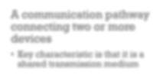
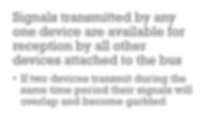













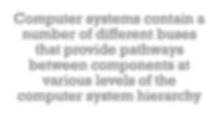

















A communication pathway connecting two or more devices
Key characteristic is that it is a shared transmission medium
Signals transmitted by any one device are available for reception by all other devices attached to the bus
If two devices transmit during the same time period their signals will overlap and become garbled
I
n
n
e
t e r c
Typically consists of multiple
communication lines
Each line is capable of transmitting signals representing binary 1 and binary 0
Computer systems contain a number of different buses that provide pathways between components at various levels of the computer system hierarchy
B
u s
c
t i
System bus
A bus that connects major computer components (processor, memory, I/O)
o
The most common computer interconnection structures are based on the use of one or more system buses
o
n
n

Slide 28


Data Bus
Data lines that provide a path for moving data among system modules
May consist of 32, 64, 128, or more separate lines
The number of lines is referred to as the width of the data bus
The number of lines determines how many bits can be transferred at a time
The width of the data bus is a key factor in determining overall system performance

Slide 29


Address Bus
+
Control Bus
Used to designate the source or destination of the data on the data bus
  If the processor wishes to read a word of data from memory it puts the address of the desired word on the address lines
Width determines the maximum possible memory capacity of the system
Also used to address I/O ports
  The higher order bits are used to select a particular module on the bus and the lower order bits select a memory location or I/O port
© 2016 Pears_{w}on _{i}E_{t}d_{h}uc_{i}a_{n}tio_{t}n_{h}, I_{e}nc._{m}, Ho_{o}b_{d}ok_{u}en_{l},_{e}NJ. All rights reserved.
Used to control the access and the use of the data and address lines
Because the data and address lines are shared by all components there must be a means of controlling their use
Control signals transmit both command and timing information among system modules
Timing signals indicate the validity of data and address information
Command signals specify
operations to be performed

Slide 30
Memory
CPU
Memory
I/O
I/O
Control lines
Address lines
Bus
Data lines
Figure 3.16 Bus Interconnection Scheme

Slide 31








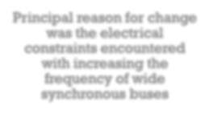
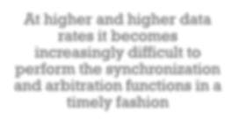




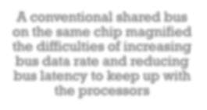

Point-to-Point Interconnect
+
Principal reason for change was the electrical constraints encountered with increasing the frequency of wide synchronous buses
At higher and higher data rates it becomes increasingly difficult to perform the synchronization and arbitration functions in a timely fashion
A conventional shared bus on the same chip magnified the difficulties of increasing bus data rate and reducing bus latency to keep up with the processors
Has lower latency, higher data rate, and better scalability

Slide 32



⁺Quick Path Interconnect
QPI
Introduced in 2008
Multiple direct connections
  Direct pairwise connections to other components eliminating the need for arbitration found in shared transmission systems
Layered protocol architecture
  These processor level interconnects use a layered protocol architecture rather than the simple use of control signals found in shared bus arrangements
Packetized data transfer
  Data are sent as a sequence of packets each of which includes control headers and error control codes

Slide 33
I/O device
I/O device
I/O Hub
DRAM
Core A
Core B
DRAM
DRAM
Core C
Core D
DRAM
I/O device
I/O device
I/O Hub
QPI
PCI Express
Memory bus
Figure 3 .1 7 Multicore Configuratio n Using QPI

Slide 34
Packets
Protocol
Routing
Link
Physical
Protocol
Routing
Link
Physical
Flits
Phits
Figure 3 .1 8
QPI Layers

Slide 35
COMPONENT A
 | Intel QuickPath Interconnect Port
 | Fwd Clk |  |  | Transmission Lanes |  |  |  |  |  |  |  |  |  |  |  |  |  |  |  |  |  |  |  |  |  |  |  | Reception Lanes |  |  |  |  |  |  |  |  |  |  |  |  |  |  |  |  |  |  |  |  |  |  |  | Rcv Clk
 | Rcv Clk |  |  | Reception Lanes |  |  |  |  |  |  |  |  |  |  |  |  |  |  |  |  |  |  |  |  |  |  |  | Transmission Lanes |  |  |  |  |  |  |  |  |  |  |  |  |  |  |  |  |  |  |  |  |  |  |  | Fwd Clk
 | Intel QuickPath Interconnect Port
COMPONENT B
Figure 3 .1 9 Physical I nterface of the I ntel QPI I nterconnect

Slide 36
#2n+1
#n+1
#1
QPI
lane 0
bit stream of flits
#2n+2
#n+2
#2
QPI
lane 1
#2n+1
#2n
#n+2
#n+1
#n
#2
#1
#3n
#2n
#n
QPI
lane 19
Figure 3.20 QPI Multilane Distribution

Slide 37

⁺ QPI Link Layer
Flow control function
  Needed to ensure that a sending QPI entity does not overwhelm a receiving QPI entity by sending data faster than the receiver can process the data and clear buffers for more incoming data
Error control function
  Detects and recovers from bit errors, and so isolates higher layers from experiencing bit errors
Performs two key functions: flow control and error control
  Operate on the level of the flit (flow control unit)
  Each flit consists of a 72-bit message payload and an 8-bit error control code called a cyclic redundancy check (CRC)

Slide 38

QPI Routing and Protocol Layers
+
Routing Layer
Protocol Layer
Packet is defined as the unit of transfer
One key function performed at this level is a cache coherency protocol which deals with making sure that main memory values held in multiple caches are consistent
A typical data packet payload is a block of data being sent to or from a cache
Used to determine the course that a packet will traverse across the available system interconnects
Defined by firmware and describe the possible paths that a packet can follow

Slide 39


⁺ Peripheral Component Interconnect (PCI)
A popular high bandwidth, processor independent bus that can function as a mezzanine or peripheral bus
Delivers better system performance for high speed I/O
subsystems
PCI Special Interest Group (SIG)
  Created to develop further and maintain the compatibility of the PCI
specifications
PCI Express (PCIe)
  Point-to-point interconnect scheme intended to replace bus-based schemes such as PCI
  Key requirement is high capacity to support the needs of higher data rate I/O devices, such as Gigabit Ethernet
  Another requirement deals with the need to support time dependent data streams

Slide 40
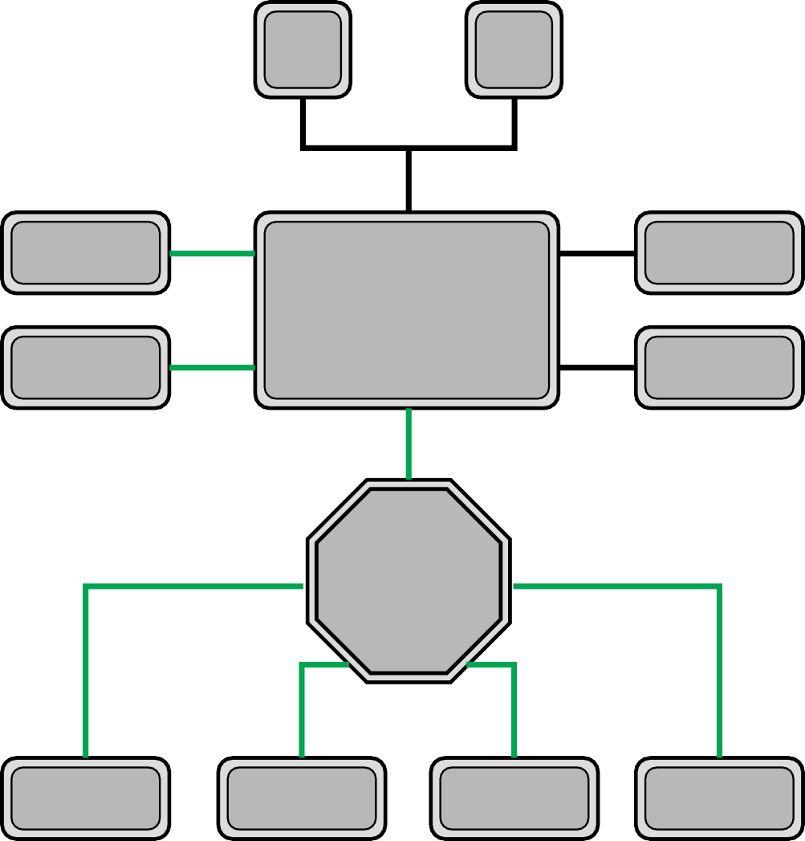
Core
Core
Gigabit Ethernet
PCIe
Memory
Chipset
PCIe–PCI
Bridge
PCIe
Memory
PCIe
PCIe
Switch
PCIe
PCIe
PCIe
Legacy endpoint
PCIe
endpoint
PCIe
endpoint
PCIe
endpoint
Figure 3 .2 1 Typical Configuration Using PCI e

Slide 41
Transaction layer packets (TLP)
Transaction
Transaction
Data link layer packets (DLLP)
Data Link
Data Link
Physical
Physical
Figure 3 .2 2
PCI e Protocol Layers

Slide 42
B4 |  | B0
128b/
130b
PCIe
lane 0
byte stream
B5 |  | B1
128b/
130b
PCIe
lane 1
B7 |  | B6 |  | B5 |  | B4 |  | B3 |  | B2 |  | B1 |  | B0
B6 |  | B2
128b/
130b
PCIe
lane 2
B7 |  | B3
128b/
130b
PCIe
lane 3
Figure 3.23 PCIe Multilane Distribution

Slide 43
D+ D–
8b
Scrambler
Differential Receiver
8b
1b
Clock recovery circuit
128b/130b Encoding
Data recovery circuit
 | 1b
130b
Parallel to serial
 | 1b
Serial to parallel
130b
Transmitter Differential Driver
128b/130b Decoding
128b
D+ D–
Descrambler
(a) Transmitter
8b
(b) Receiver
Figure 3.24 PCIe Transmit and Receive Block Diagrams

Slide 44




+
PCIe
Transaction Layer (TL)
Receives read and write requests from the software above the TL and creates request packets for transmission to a destination via the link layer
Most transactions use a split transaction technique
  A request packet is sent out by a source PCIe device which then waits for a response called a completion packet
TL messages and some write transactions are posted transactions (meaning that no response is expected)
TL packet format supports 32-bit memory addressing and extended 64-bit memory addressing
© 2016 Pearson Education, Inc., Hoboken, NJ. All rights reserved.

Slide 45


⁺ The TL supports four address spaces:
Memory
  The memory space includes system main memory and PCIe I/O devices
  Certain ranges of memory addresses map into I/O devices
Configuration
  This address space enables the TL to read/write configuration registers associated with I/O devices
I/O
  This address space is used for legacy PCI devices, with reserved address ranges used to address legacy I/O devices
Message
  This address space is for control signals related to interrupts, error handling, and power management

Slide 46
Table 3.2
PCIe TLP Transaction Types
Address Space | TLP Type | Purpose
M emory | Memory Read Request | Transfer data to or from a location in the system memory map.
 | Memory Read Lock Request
 | Memory Write Request
I /O | I/O Read Request | Transfer data to or from a location in the system memory map for legacy devices.
 | I/O Write Request
Configuration | Config Type 0 Read Request | Transfer data to or from a location in the configuration space of a PCIe device.
 | Config Type 0 Write Request
 | Config Type 1 Read Request
 | Config Type 1 Write Request
M essage | Message Request | Provides in-band messaging and event reporting.
 | Message Request with Data
M emory, I /O, Configuration | Completion | Returned for certain requests.
 | Completion with Data
 | Completion Locked
 | Completion Locked with Data

Slide 47
Number of octets
1
STP framing
Sequence number
Header
Data
ECRC
LCRC
STP framing
1
Start
DLLP
CRC
End
2
Appended by PL
4
2
Created by DLL
12 or 16
1
Created by Transaction Layer
Appended by Data Link Layer
Appended by Physical Layer
0 to 4096
0 or 4
4
1
(a) Transaction Layer Packet (b) Data Link Layer Packet
Figure 3 .2 5 PCI e Protocol Data Unit Form at

Slide 48
Summary
+
A Top-Level View of Computer Function and Interconnection
Chapter 3
Point-to-point interconnect
  QPI physical layer
  QPI link layer
  QPI routing layer
  QPI protocol layer
PCI express
  PCI physical and logical
architecture
  PCIe physical layer
  PCIe transaction layer
  PCIe data link layer
Computer components
Computer function
  Instruction fetch and execute
  Interrupts
  I/O function
Interconnection structures
Bus interconnection

Slide 49
+
William Stallings Computer Organization and Architecture
10th Edition
© 2016 Pearson Education, Inc., Hoboken,
NJ. All rights reserved.

Slide 50
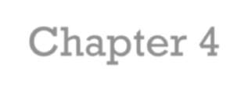
₊ Chapter 4
Cache Memory

Slide 51
Location Internal (e.g. processor registers, cache, main memory) External (e.g. optical disks, magnetic disks, tapes) Capacity Number of words Number of bytes Unit of Transfer Word Block Access M ethod Sequential Direct Random Associative | Performance Access time Cycle time Transfer rate Physical Type Semiconductor Magnetic Optical Magneto-optical Physical Characteristics Volatile/nonvolatile Erasable/nonerasable Organization Memory modules
Table 4.1
Key Characteristics of Computer Memory Systems

Slide 52


Characteristics of Memory Systems
+
Location
  Refers to whether memory is internal and external to the computer
  Internal memory is often equated with main memory
  Processor requires its own local memory, in the form of registers
  Cache is another form of internal memory
  External memory consists of peripheral storage devices that are accessible to the processor via I/O controllers
Capacity
  Memory is typically expressed in terms of bytes
Unit of transfer
  For internal memory the unit of transfer is equal to the number of electrical lines into and out of the memory module

Slide 53

⁺ Method of Accessing Units of Data
Sequential Access:
Whenever any access request arrives, the memory is searched from the beginning till the required data is found
Search begins at the first memory location and proceeds sequentially moving ahead one step at a time till the desired location is reached
Time taken to access any location is the variable.
Simple but slow technique
Tapes is an example of sequential access.

Slide 54
⁺ Method of Accessing Units of Data
Random Access:
Data represent at any memory location can be accessed directly
Time taken to access any location is the same.
Faster way to retrieve data.
RAM is an example of this kind of access.
Direct Access:
it’s semi-random mode of operation in which data is stored in blocks
/tracks which can be accessed randomly.
Unlike random access the time taken to access any location may not be
the same
Used by magnetic disk

Slide 55
⁺ Method of Accessing Units of Data
Associative:
When data is accessed by data content rather than data address, then the memory is referred to as associative memory or content addressable memory (CAM).
Data is stored at the very first empty location found in memory.
In associative memory when data is stored at a particular location then no address is stored along with it.
When the stored data need to be searched then only the key(i.e. data or part of data) is provided.
A sequential search is performed in the memory using the
specified key to find out the matching key from the memory.

Slide 56
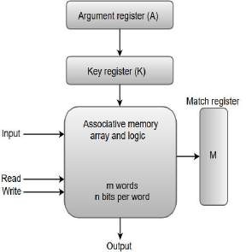
⁺ Block Diagram of Associative
Argument Register (A): It contains the word to be searched.
Key register (K): This specifies which part of the argument word needs to be compared with words in memory. If all bits in register are 1, the entire word should be compared else only the bits having 1 will be compared.
Associative memory array: it contains the words which are to be compared with the argument word
Match register (M): After the matching process the bits corresponding to matching words in match register are set to 1

Slide 57
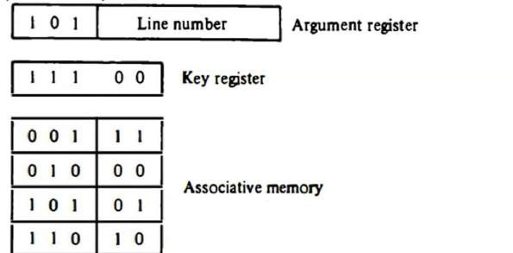
⁺ Associative example
0
0
1
0

Slide 58













Method of Accessing Units of Data
Sequential
access
Direct
access
Random
access
Associative
Memory is organized into units of data called records
Involves a shared read-write mechanism
Each addressable location in memory has a unique, physically wired-in addressing mechanism
A word is retrieved based on a portion of its contents rather than its address
Individual blocks or records have a unique address based on physical location
The time to access a given location is independent of the sequence of prior accesses and is constant
Each location has its own addressing mechanism and retrieval time is constant independent of location or prior access patterns
Access must be made in a specific linear sequence
Any location can be selected at random and directly addressed and accessed
Cache memories may employ associative access
Access time is variable
Access time is variable
Main memory and some cache systems are random access

Slide 59







Capacity and Performance:
The two most important characteristics of memory
Three performance parameters are used:
Access time (latency)
For random-access memory it is the time it takes to perform a read or write operation
For non-random-access memory it is the time it takes to position the read-write mechanism at the desired location
Memory cycle time
Access time plus any additional time required before second access can commence
Additional time may be required for transients to die out on signal lines or to regenerate data if they are read destructively
Concerned with the system bus,
not the processor
Transfer rate
The rate at which data can be transferred into or out of a memory unit
For random-access memory it is equal to 1/(cycle time)

Slide 60


Memory
+
The most common forms are:
  Semiconductor memory
  Magnetic surface memory
  Optical
  Magneto-optical
Several physical characteristics of data storage are important:
  Volatile memory
    Information decays naturally or is lost when electrical power is switched off
  Nonvolatile memory
    Once recorded, information remains without deterioration until deliberately changed
    No electrical power is needed to retain information
  Magnetic-surface memories
    Are nonvolatile
  Semiconductor memory
    May be either volatile or nonvolatile
  Nonerasable memory
    Cannot be altered, except by destroying the storage unit
    Semiconductor memory of this type is known as read-only memory (ROM)
For random-access memory the organization is a key design issue
  Organization refers to the physical arrangement of bits to form words

Slide 61
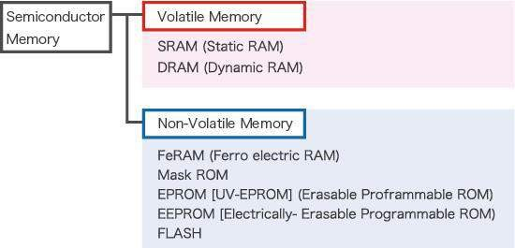
⁺ Semiconductor memory

Slide 62

⁺ Memory Hierarchy
Design constraints on a computer’s memory can be summed
up by three questions:
  How much, how fast, how expensive
There is a trade-off among capacity, access time, and cost
  Faster access time, greater cost per bit
  Greater capacity, smaller cost per bit
  Greater capacity, slower access time
The way out of the memory dilemma is not to rely on a single memory component or technology, but to employ a memory hierarchy

Slide 63
Reg-
isters
Inboard
Cache
memory
Main
memory
Outboard
Magnetic disk
storage
CD-ROM
CD-RW
DVD-RW
DVD-RAM
Blu-Ray
Off-line
Magnetic tape
storage
Figure 4.1 The Memory Hierarchy

Slide 64
⁺ Memory
The use of three levels exploits the fact that semiconductor memory comes in a variety of types which differ in speed and cost
Data are stored more permanently on external mass storage
devices
External, nonvolatile memory is also referred to as
secondary memory or auxiliary memory
Disk cache
  A portion of main memory can be used as a buffer to hold data temporarily that is to be read out to disk
  A few large transfers of data can be used instead of many small
transfers of data
  Data can be retrieved rapidly from the software cache rather than slowly from the disk

Slide 65
Block Transfer
Word Transfer
Main Memory
CPU
Cache
Fast
Slow
(a) Single cache
Main Memory
Level 2 (L2) cache
Level 3 (L3) cache
CPU
Level 1 (L1) cache
Fastest
Fast
Less
Slow
fast
(b) Three-level cache organization
Figure 4.3 Cache and Main Memory

Slide 66
+
In Figure 4.3a.The cache contains a copy of portions of main memory. When the processor attempts to read a word of memory, a check is made to determine if the word is in the cache. If so, the word is delivered to the processor. If not, a block of main memory, consisting of some fixed number of words, is read into the cache and then the word is delivered to the processor. Because of the phenomenon of locality of reference, when a block of data is fetched into the cache to satisfy a single memory reference, it is likely that there will be future references to that same memory location or to other words in the block
Figure 4.3b depicts the use of multiple levels of cache. The L2 cache is slower and typically larger than the L1 cache, and the L3 cache is slower and typically larger than the L2 cache.

Slide 67
Line Number
0
1
2
Memory address
Tag
Block
0
1
2
3
Block 0 (K words)
C – 1
Block Length
(K Words)
(a) Cache
Block M – 1
2^{n} – 1
Word
Length
(b) Main memory
Figure 4.4 Cache/Main-Memory Structure

Slide 68
START
Receive address RA from CPU
Is block containing RA in cache?
No
Access main memory for block containing RA
Yes
Fetch RA word and deliver
to CPU
Allocate cache line for main
memory block
Load main memory block into cache line
Deliver RA word to CPU
DONE
Figure 4.5
Cache Read Operation

Slide 69

Processor | Address
 |  | Ad
dress buffer
System Bus
Control
Cache
Control
Data buffer
Data
Figure 4.6
Typical Cache Organization

Slide 70
⁺ Cache organization
In figure 4.6, the cache connects to the processor via data, control, and address lines. The data and address lines also attach to data and address buffers, which attach to a system bus from which main memory is reached.
When a cache hit occurs, the data and address buffers are disabled and communication is only between processor and cache, with no system bus traffic.
When a cache miss occurs, the desired address is loaded onto the system bus and the data are returned through the data buffer to both the cache and the processor.
In other organizations, the cache is physically interposed between the processor and the main memory for all data, address, and control lines. In this latter case, for a cache miss, the desired word is first read into the cache and then transferred from cache to processor.

Slide 71
Write Policy
Cache Addresses Logical Physical
Cache Size
M apping Function
Direct Associative
Set Associative
Replacement Algorithm Least recently used (LRU) First in first out (FIFO)
Least frequently used (LFU)
Random
Write through Write back
Line Size
Number of caches
Single or two level Unified or split
Table 4.2 Elements of Cache Design

Slide 72

⁺ Cache Addresses
Virtual Memory
Virtual memory
  Facility that allows programs to address memory from a logical point of view, without regard to the amount of main memory physically available
  When used, the address fields of machine instructions contain virtual addresses
  For reads to and writes from main memory, a hardware memory management unit (MMU) translates each virtual address into a physical address in main memory

Slide 73
Processor | Logical address
 | Cache
Main memory
MMU
Physical address
Data
(a) Logical Cache
Processor
Main memory
Logical address
MMU
Physical address
Cache
Data
(b) Physical Cache
Figure 4.7 Logical and Physical Caches

Slide 74
⁺ Logical and physical caches
When virtual addresses are used, the system designer may choose to place the cache between the processor and the MMU or between the MMU and main memory (Figure 4.7).
A logical cache, also known as a virtual cache, stores data using virtual addresses. The processor accesses the cache directly, without going through the MMU.
A physical cache stores data using main memory physical addresses.
One obvious advantage of the logical cache is that cache access speed is faster than for a physical cache, because the cache can respond before the MMU performs an address translation.
While the disadvantage is, each application sees a virtual memory that starts at address 0. Thus, the same virtual address in two different applications refers to two different physical addresses, The cache memory must therefore be completely flushed with each application context switch

Slide 75
⁺ Cache size
Small enough so that the overall average cost per bit is close to that of main memory alone and
Large enough so that the overall average access time is close to that of the cache alone
The larger the cache, the larger the number of gates involved in addressing the cache. The result is that large caches tend to be slightly slower than small ones – even when built with the same integrated circuit technology and put in the same place on chip and circuit board
The available chip and board area also limits cache size
Because the performance of the cache is very sensitive to the nature of the workload, it is impossible to arrive at a single ‘optimum’ cache size

Slide 76

Mapping Function
Because there are fewer cache lines than main memory blocks, an algorithm is needed for mapping main memory blocks into cache lines
Three techniques can be used:
Direct mapping :
  The simplest technique, known as direct mapping, maps each block of main memory into only one possible cache line.
  The mapping is expressed as
i= j Mod m
Where : i = cache line number
j = main memory block number m = number of lines in the cache

Slide 77
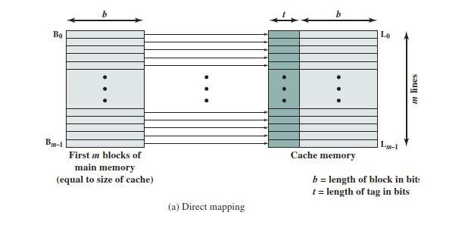
Figure 4.8 Mapping from Main Memory to Cache: Direct
Figure 4.8a shows the mapping for the first m blocks of main memory. Each block of main memory maps into one unique line of the cache. The next m blocks of main memory map into the cache in the same fashion; that is, block B_{m} of main memory maps into line L₀ of cache, block _{Bm+1} maps into line L₁, and so on.

Slide 78
⁺ Example
If Cache size = 64 Kbytes and block size=4 bytes and memory size =16 Mbyte? Find total number of blocks in main memory and total cache lines within cache memory.

Slide 79
⁺ Direct Mapping
Each block of main memory maps to only one cache line
Address is two parts
W: least significant bits identify unique word
S: Most significant bits identify one memory block
S-bits are split into s-r: Tag bits r:cache line

Slide 80


⁺ Direct Mapping Summary
Address length = (s + w) bits
Number of addressable units = 2^{s+w} words or bytes
Block size = line size = 2^{w} words or bytes
Number of blocks in main memory = 2^{s+ w}/2^{w} = 2^{s}
Number of lines in cache = m = 2^{r}
Size of tag = (s – r) bits

Slide 81


s+w
Cache
Tag Data
Main Memory
Memory Address
WO
Tag
Line
Word
W1
B₀
L₀
W2
s–r
r
w
W3
s–r
s
W4j
w
L_{i}
W(4j+1)
B
Compare
w
j
W(4j+2)
W(4j+3)
1 if match
0 if no match
(hit in cache)
^{L}m–1
if match
if no match
(miss in cache)
Figure 4.9
Direct-Mapping Cache Organization

Slide 82
Figure 4.9 illustrates the general mechanism .
For purposes of cache access, each main memory address can be viewed as consisting of three fields.
The least significant w bits identify a unique word or byte within a block of main memory; in most contemporary machines, the address is at the byte level .
The remaining s bits specify one of the 2^{𝑠} blocks of main memory.
The cache logic interprets these s bits as a tag of s - r bits
(most significant portion) and a line field of r bits .
This latter field identifies one of the m = 2^{𝑟} lines of the cache

Slide 83
Advantage and disadvantage Direct mapping
+
The direct mapping technique is simple and inexpensive to
implement. Its
main disadvantage is that there is a fixed cache location for any given block. Thus, if a program happens to reference words repeatedly from two different blocks that map into the same line, then the blocks will be continually swapped in the cache, and the hit ratio will be low (a phenomenon known as thrashing).

Slide 84
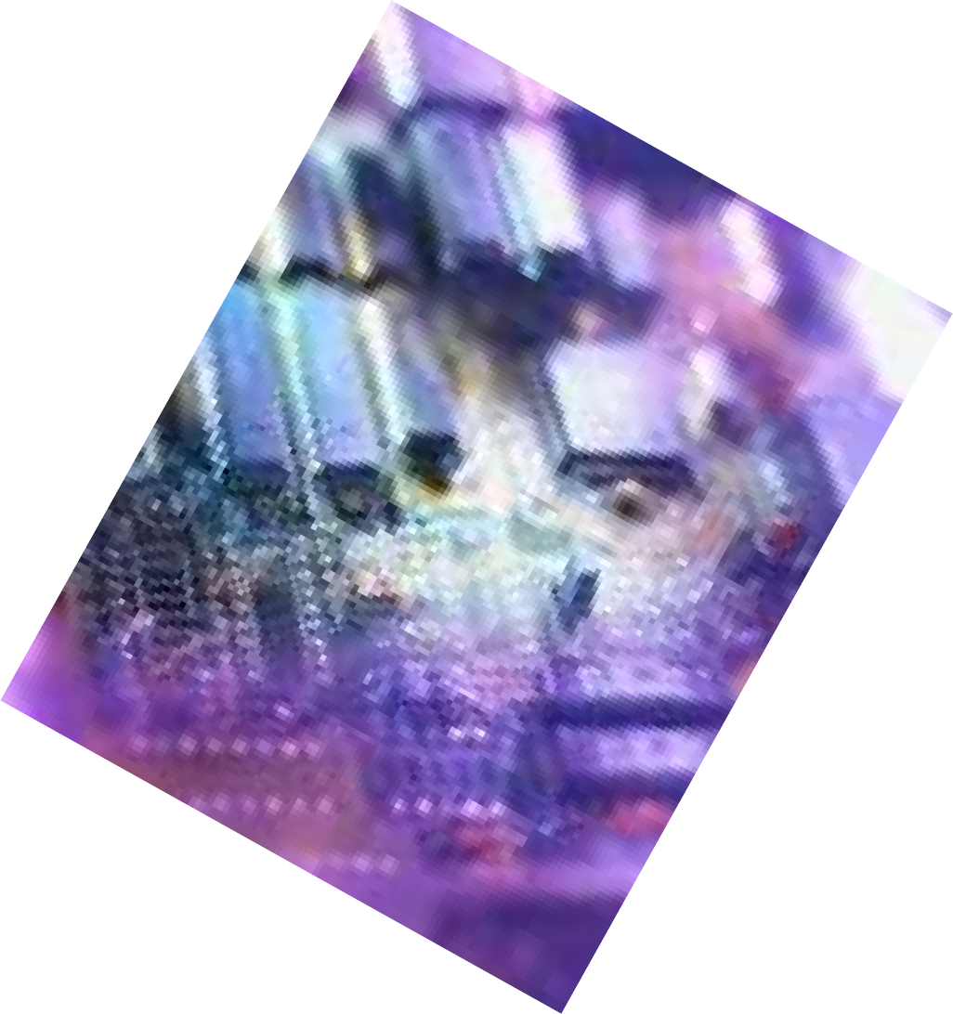

⁺ Fully associative mapping
Originally proposed as an approach to reduce the conflict misses of direct mapped caches without affecting its fast access time
Also called victim cache
Typical size is 4 to 16 cache lines
Residing between direct mapped L1 cache and the next level of memory

Slide 85
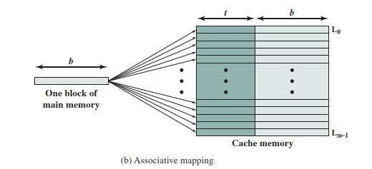
⁺ Associative mapping
Overcome the disadvantage of direct mapping by permitting each main memory block to be loaded into any line of the cache

Slide 86

⁺ Associative mapping
The cache control logic interprets a memory address simply as a Tag and A word field.
The Tag field uniquely identifies a block of main memory
To determine whether a block is in the cache, the cache control logic must simultaneously examine every line’s tag for a match
Word is used for specific access within block
2 bit word ➔ 1 out of 4 words
4 bit word → 1 out of 16 words

Slide 87


s+w
Cache
Tag Data
Main Memory
Memory Address
W0
W1
W2
W3
Tag
Word
B
L
0
s
0
w
w
L_{j}
W4j
W(4j+1)
W(4j+2)
W(4j+3)
s
Compare
w
B
j
1 if match
0 if no match
(hit in cache)
s
^{L}m–1
0 if match
^{1 if no match} (miss in cache)
Figure 4.11 Fully Associative Cache Organization

Slide 88

⁺ Associative Mapping Summary
Address length = (s + w) bits
Number of addressable units = 2^{s+w} words or bytes
Block size = line size = 2^{w} words or bytes
Number of blocks in main memory = 2^{s+ w}/2^{w} = 2^{s}
Number of lines in cache = undetermined
Size of tag = s bits

Slide 89
⁺ Example
Using mapping If Cache size = 64 Kbytes and block size=4 bytes and memory size =16 Mbyte? Find total number of blocks in main memory, and the content of memory address
Sol
→

Slide 90
⁺ Associative Mapping Pros & Cons
With associative mapping there is flexibility as to which block to replace when a new block is read into the cache.
→ Note: Replacement algorithms are designed to maximize the
hit ratio.
→ Complex circuitry required to examine the tags of all cache lines in parallel

Slide 91

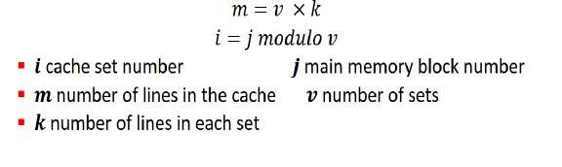
Set Associative Mapping
+
Compromise that exhibits the strengths of both the direct and associative approaches while reducing their disadvantages
The cache consists of several sets, each of which consists of
several lines

Slide 92
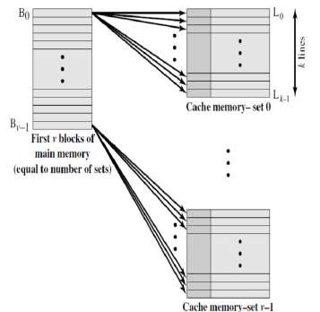
⁺ Set Associative Mapping
Each word maps into all the cache lines in a specific set
Set-associative cache can be Physically implemented as associative caches

Slide 93

⁺ Set Associative Mapping
Cache size : 64 Kbytes.
Block size: 4 bytes
Cache is organized as 16 𝐾 = 2¹⁴ lines of 4 bytes each.
Memory Size: 16 Mbytes, with each byte directly addressable
by a 24-bit address (2²⁴ = 16 𝑀).
Main memory: (2²² =4M )blocks of 4 bytes each
each set contain 2 line then
# of set(v)= 2¹⁴ / 2¹ =2¹³ = 8 K
Size of tag= (s-d) → 22-13 = 9
tag
9
set
13
word
2

Slide 94
⁺ Set Associative Mapping
Memory address as three fields: Tag, Set, and Word.
The d set bits specify one of 𝑣 = 𝟐^{𝒅} sets
The 𝒔 bits of the Tag and Set fields specify one of the 𝟐^{𝒔}
blocks of main memory.
Number of sets(v) can be calculate by dividing cache size into k( number of line in each set)

Slide 95


s+w
Cache
Tag Data
Main Memory
Memory Address
B₀
Tag
Set
Word
 | F₀
 | F₁
B₁
s–d
d
w
Set 0
s–d
^{F}k–1
F_{k}
s+w
B_{j}
Compare
^{F}k+i
Set 1
(hit in cache)
^{F}2k–1
1 if match
0 if no match
if match
if no match
(miss in cache)
Figure 4.14
k-Way Set Associative Cache Organization

Slide 96
Figure 4.14 illustrates the cache control logic. With fully associative mapping, the tag in a memory address is quite large and must be compared to the tag of every line in the cache. With k-way set-associative mapping, the tag in a memory address is much smaller and is only compared to the k tags within a single set

Slide 97

⁺ Set Associative Mapping Summary
Address length = (s + w) bits
Number of addressable units = 2^{s+w} words or bytes
Block size = line size = 2^{w} words or bytes
Number of blocks in main memory = 2^{s+w/}2^{w=}2^{s}
Number of lines in set = k
Number of sets = v = 2^{d}
Number of lines in cache = m=kv = k * 2^{d}
Size of cache = k * 2^{d+w} words or bytes
Size of tag = (s – d) bits

Slide 98
⁺ Set Associative Mapping
In the extreme case of 𝑣 = 𝑚, 𝑘 = 1, the set-associative technique reduces to direct mapping
for 𝑣 = 1, 𝑘 = 𝑚, it reduces to associative mapping.
The use of two lines per set (𝑣 = m/2, k = 2) is the most
common set-associative organization

Slide 99


⁺ Replacement Algorithms
Once the cache has been filled, when a new block is brought into the cache, one of the existing blocks must be replaced
For direct mapping there is only one possible line for any particular block and no choice is possible
For the associative and set-associative techniques a replacement algorithm is needed
To achieve high speed, an algorithm must be implemented in hardware

Slide 100
+ The most common replacement algorithms are:
Least recently used (LRU)
  Most effective
  Replace that block in the set that has been in the cache longest with no reference to it
  Because of its simplicity of implementation, LRU is the most popular replacement algorithm
First-in-first-out (FIFO)
  Replace that block in the set that has been in the cache longest
  Easily implemented as a round-robin or circular buffer technique
Least frequently used (LFU)
  Replace that block in the set that has experienced the fewest references
  Could be implemented by associating a counter with each line

Slide 101











Write Policy
When a block that is resident in the cache is to be replaced there are two cases to consider:
There are two problems to contend with:
If the old block in the cache has not been altered then it may be overwritten with a new block without first writing out the old block
More than one device may have access to
main memory
If at least one write operation has been performed on a word in that line of the cache then main memory must be updated by writing the line of cache out to the block of memory before bringing in the new block
A more complex problem occurs when multiple processors are attached to the same bus and each processor has its own local cache - if a word is altered in one cache it could conceivably invalidate a word in other caches

Slide 102


⁺ Write Through
and Write Back
Write through
  Simplest technique
  All write operations are made to main memory as well as to the cache
  The main disadvantage of this technique is that it generates substantial
memory traffic and may create a bottleneck
Write back
  Minimizes memory writes
  Updates are made only in the cache
  When an update occurs, a dirty bit, or use bit, associated with the line is set. Then, when a block is replaced, it is written back to main memory if and only if the dirty bit is set
  The problem with write back is “cache coherent” different copies for
block between cache and main memory

Slide 103
Summary
+
Cache Memory
Chapter 4
Elements of cache design
  Cache addresses
  Cache size
  Mapping function
  Replacement algorithms
  Write policy
  Line size
  Number of caches
Computer memory system overview
  Characteristics of
Memory Systems
  Memory Hierarchy
Cache memory
principles
Pentium 4 cache organization

